Slide 1


Surgery in the Climate Emergency: Responsibility Without Borders
Josh Ng-Kamstra MDCM,MPH FRCSC FACS

Slide 2
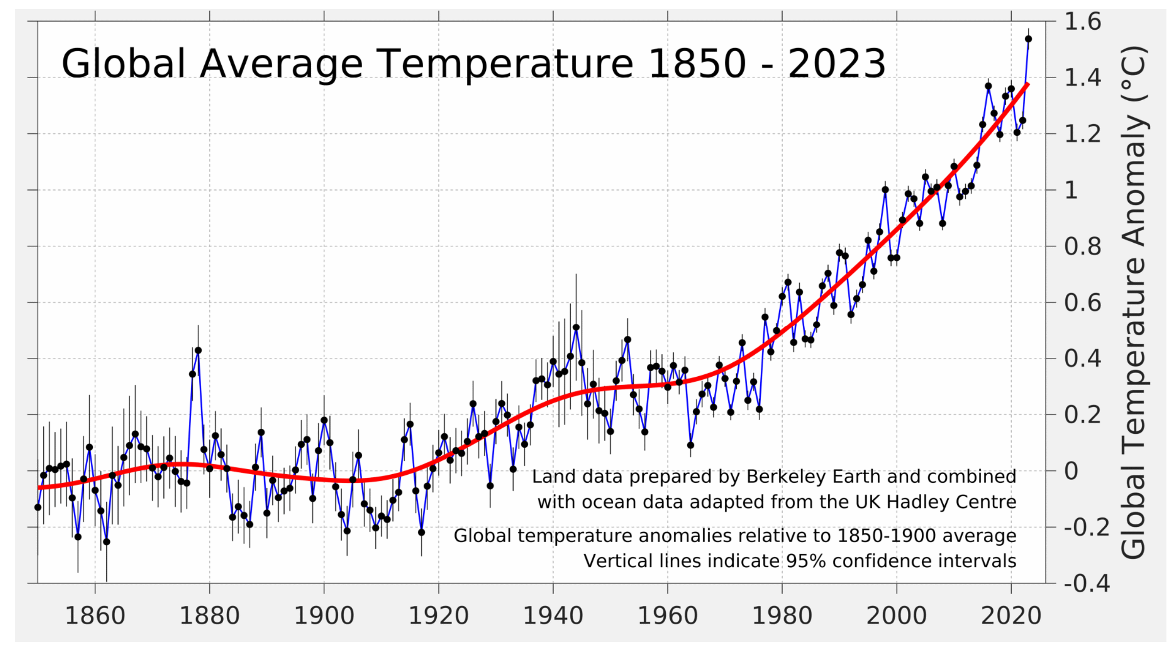

Slide 3
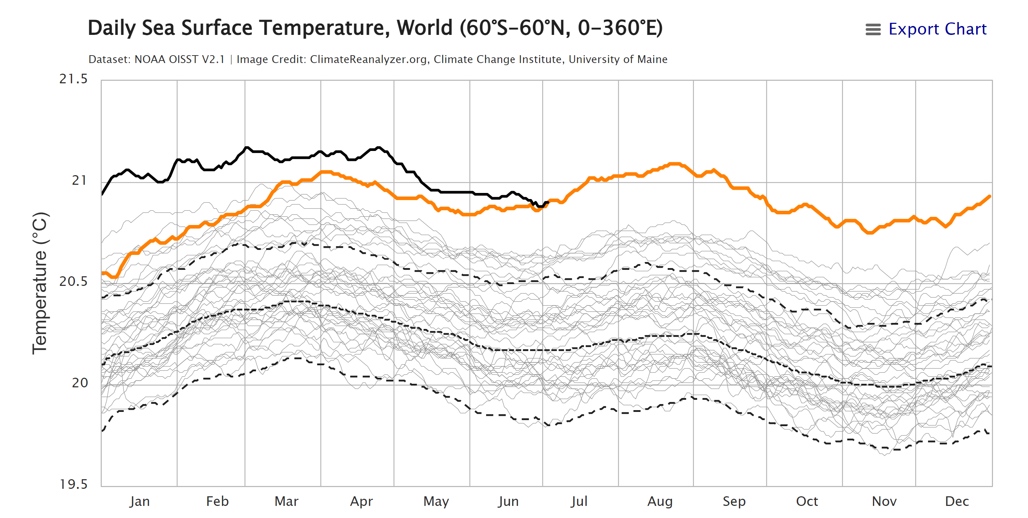

Slide 4
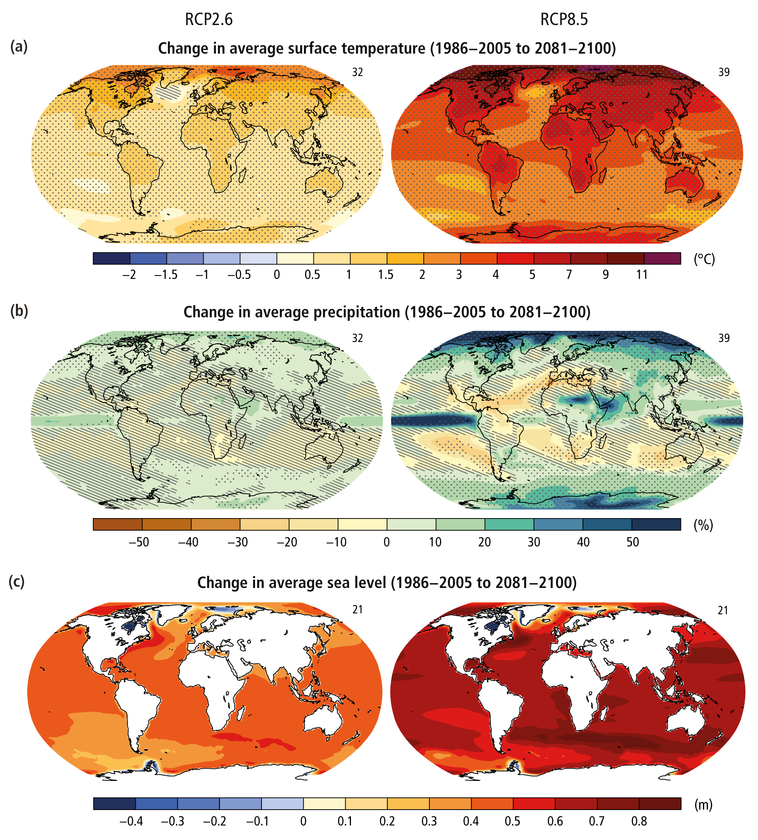

Slide 5


Slide 6


Slide 7
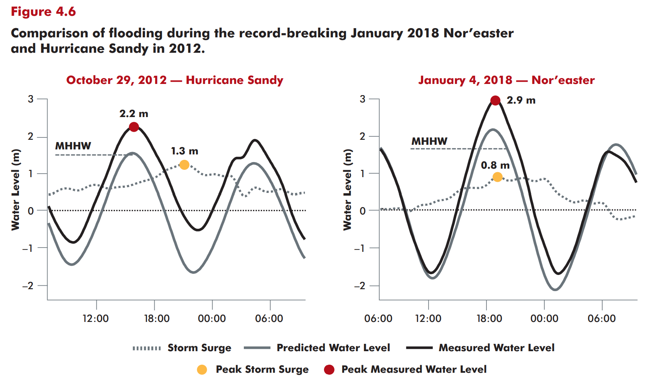
2-3 ft of sea level rise by 2100

Slide 8
“Climate change implies precipitous declines in output, capital and consumption that exceed 50% by 2100. These changes imply a 31% welfare loss in permanent consumption equivalent in 2024, that grows to nearly 52% by 2100. These magnitudes are comparable to the economic damage caused by fighting a war domestically and permanently.”
-Bilal & Känzig, 2024

Slide 9
What does this have to do with surgery & healthcare?

Slide 10
We’re responsible

Slide 11
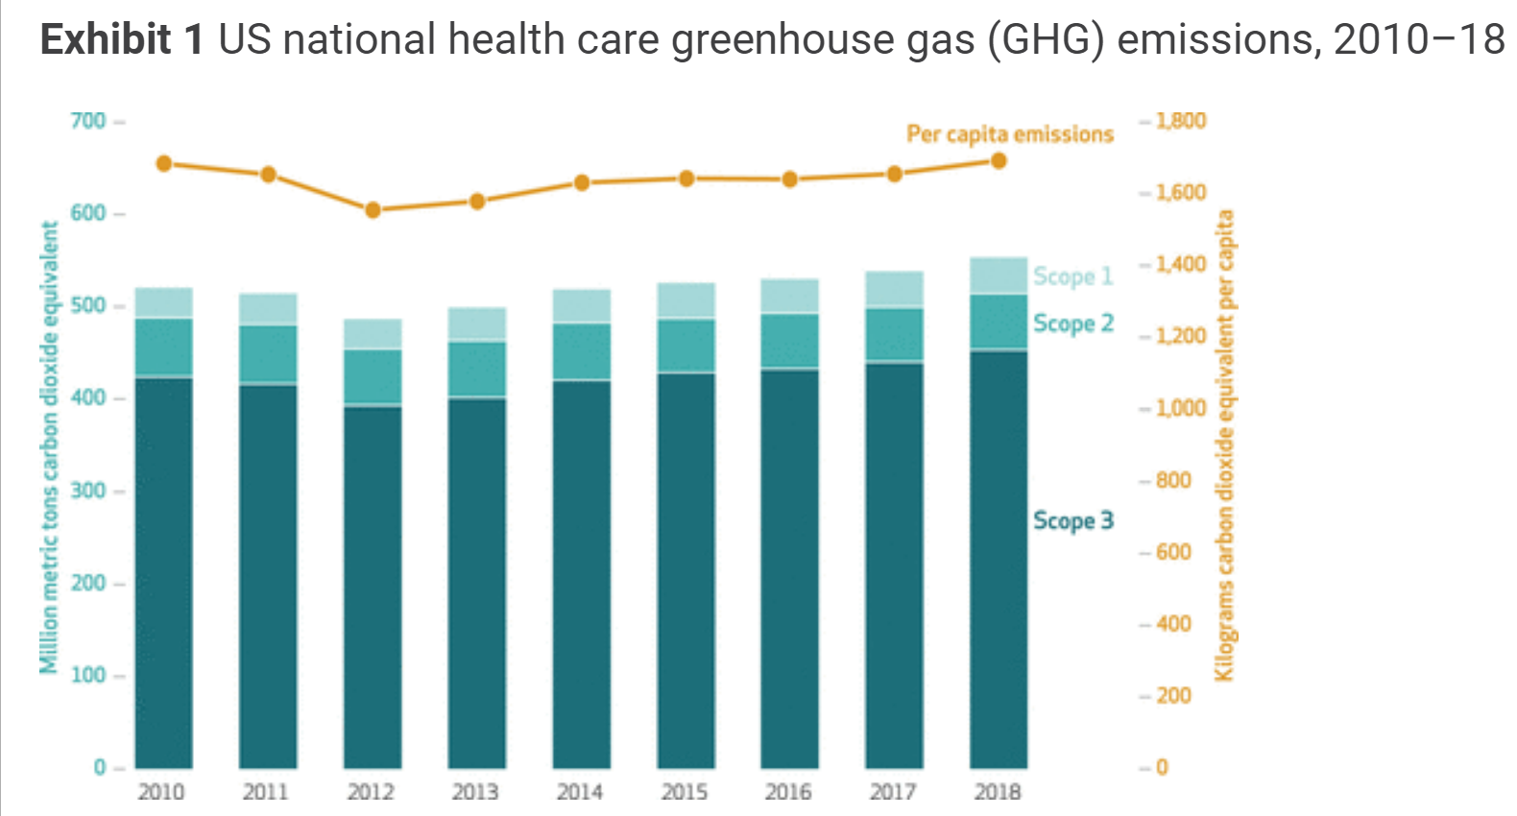

Slide 12
Why focus on surgery?
“Operating rooms (ORs) account for 20 to 33 percent of hospital waste and can be three to six times more energy-intensive than hospitals as a whole.”

Slide 13
How do we know how much CO2 the surgery we do is generating?

Slide 14
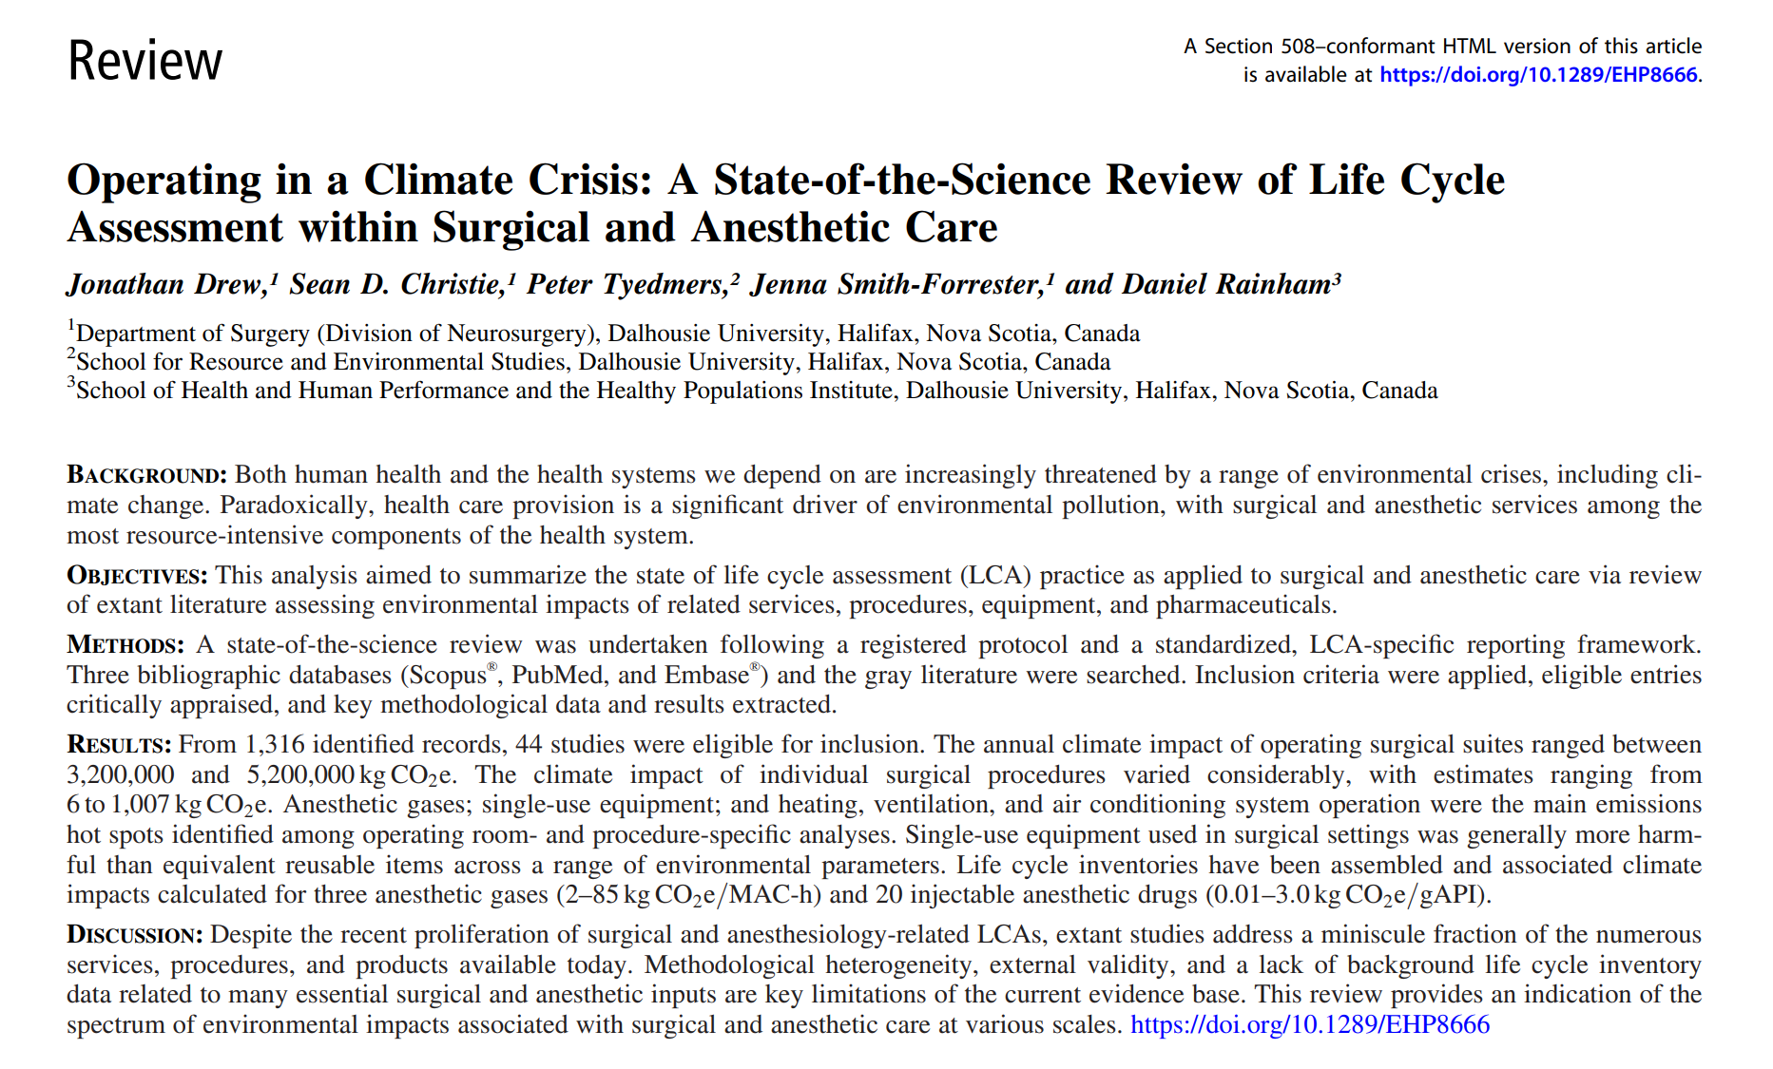

Slide 15
What does this have to do with surgery & healthcare?

Slide 16

We need to be ready.

Slide 17
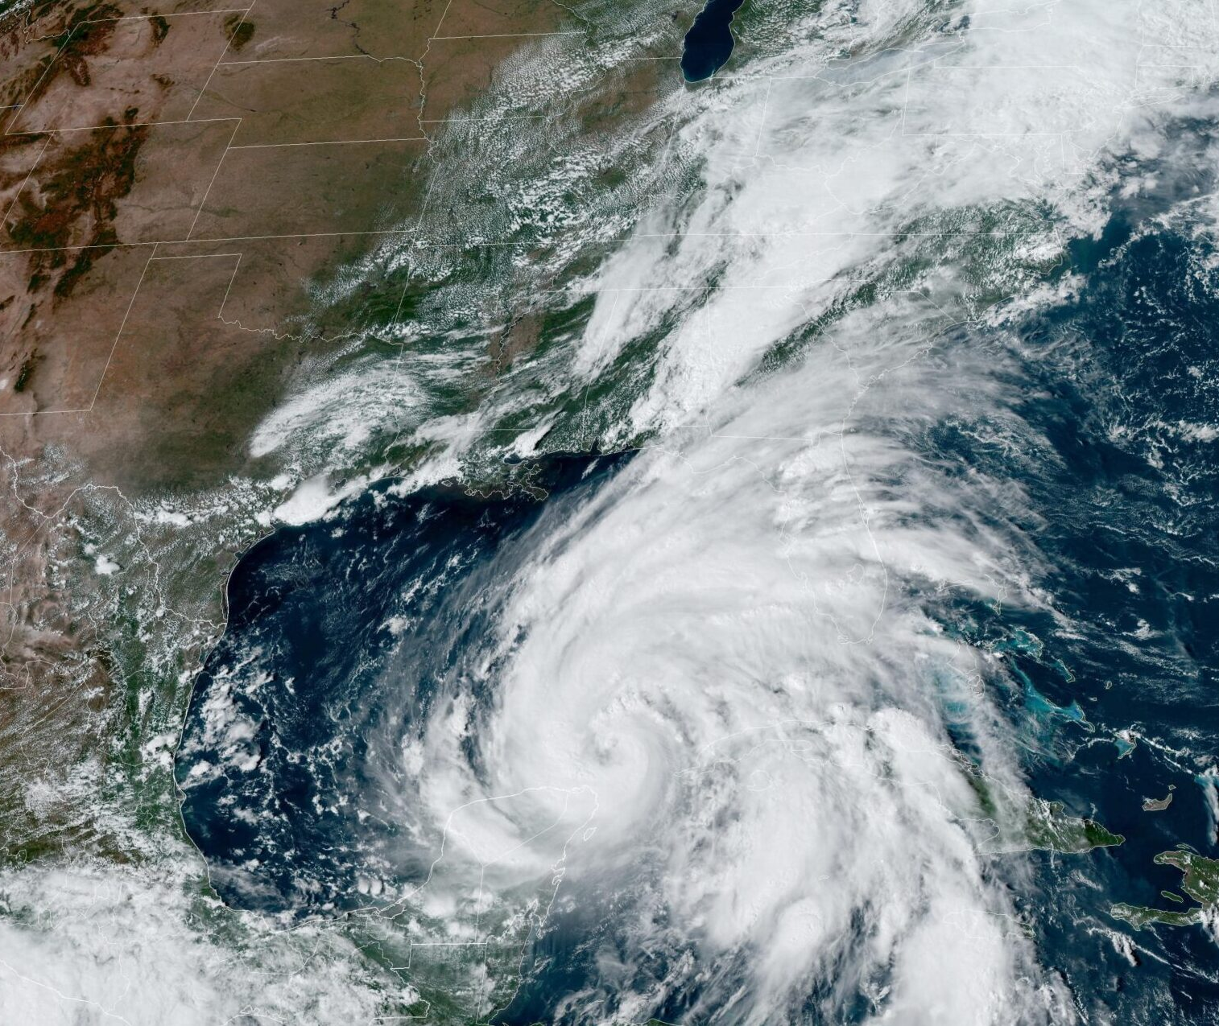
The climate has already changed

Slide 18
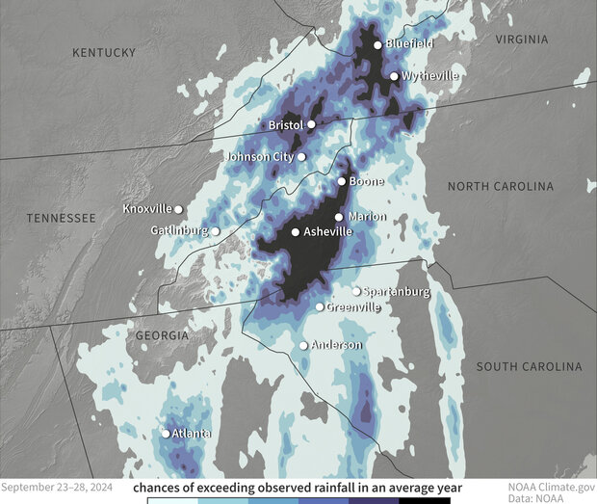

Slide 19

3-day rainfall totals were 70% more likely as a result of climate change
Storms like Helene are 150% more frequent in the region (once every 53 as opposed to 150 years) due to climate change
Wind speeds 11% more intense as a result of climate change

Slide 20
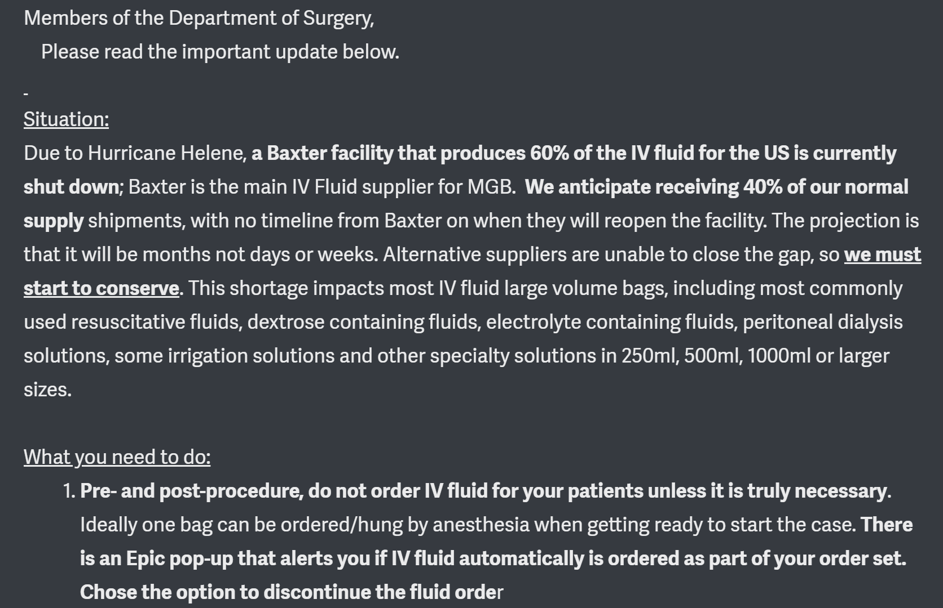
“A Baxter facility that produces 60% of the IV fluid for the US is currently shut down; Baxter is the main IV fluid supplier for MGB”

Slide 21
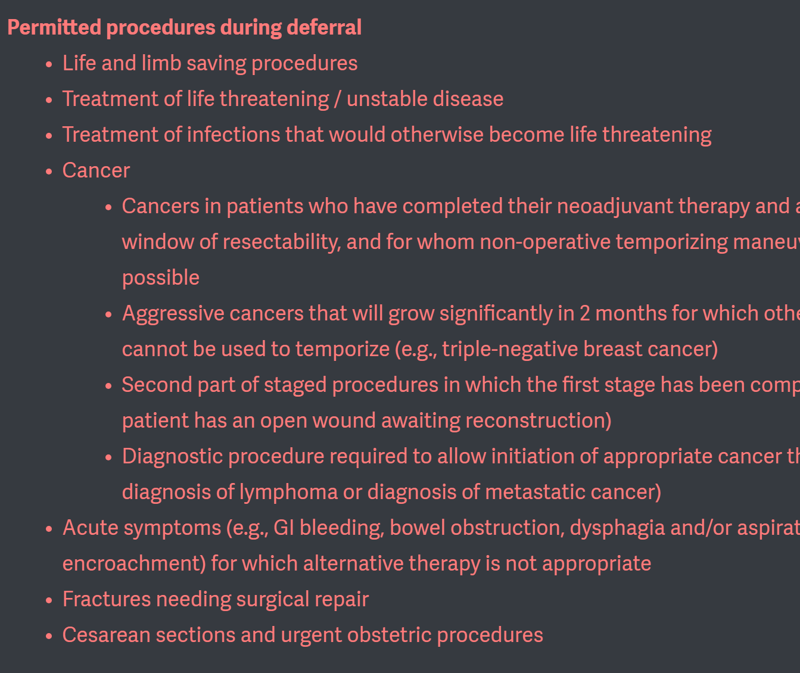
“Permitted procedures during deferral:
-Life and limb saving procedures. . .”

Slide 22
What does this have to do with surgery globally?

Slide 23


Slide 24
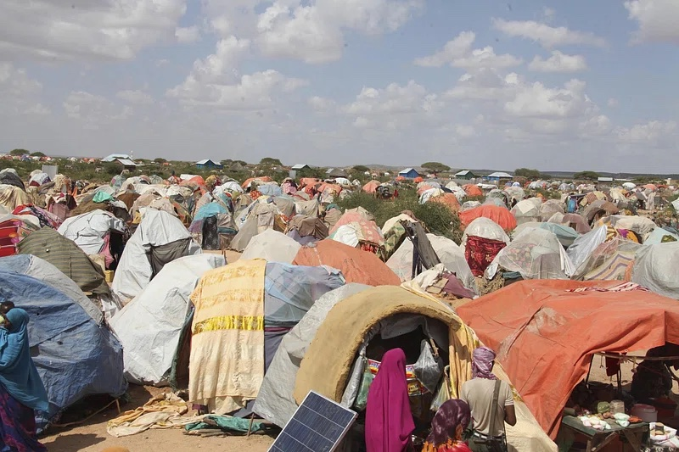


Slide 25
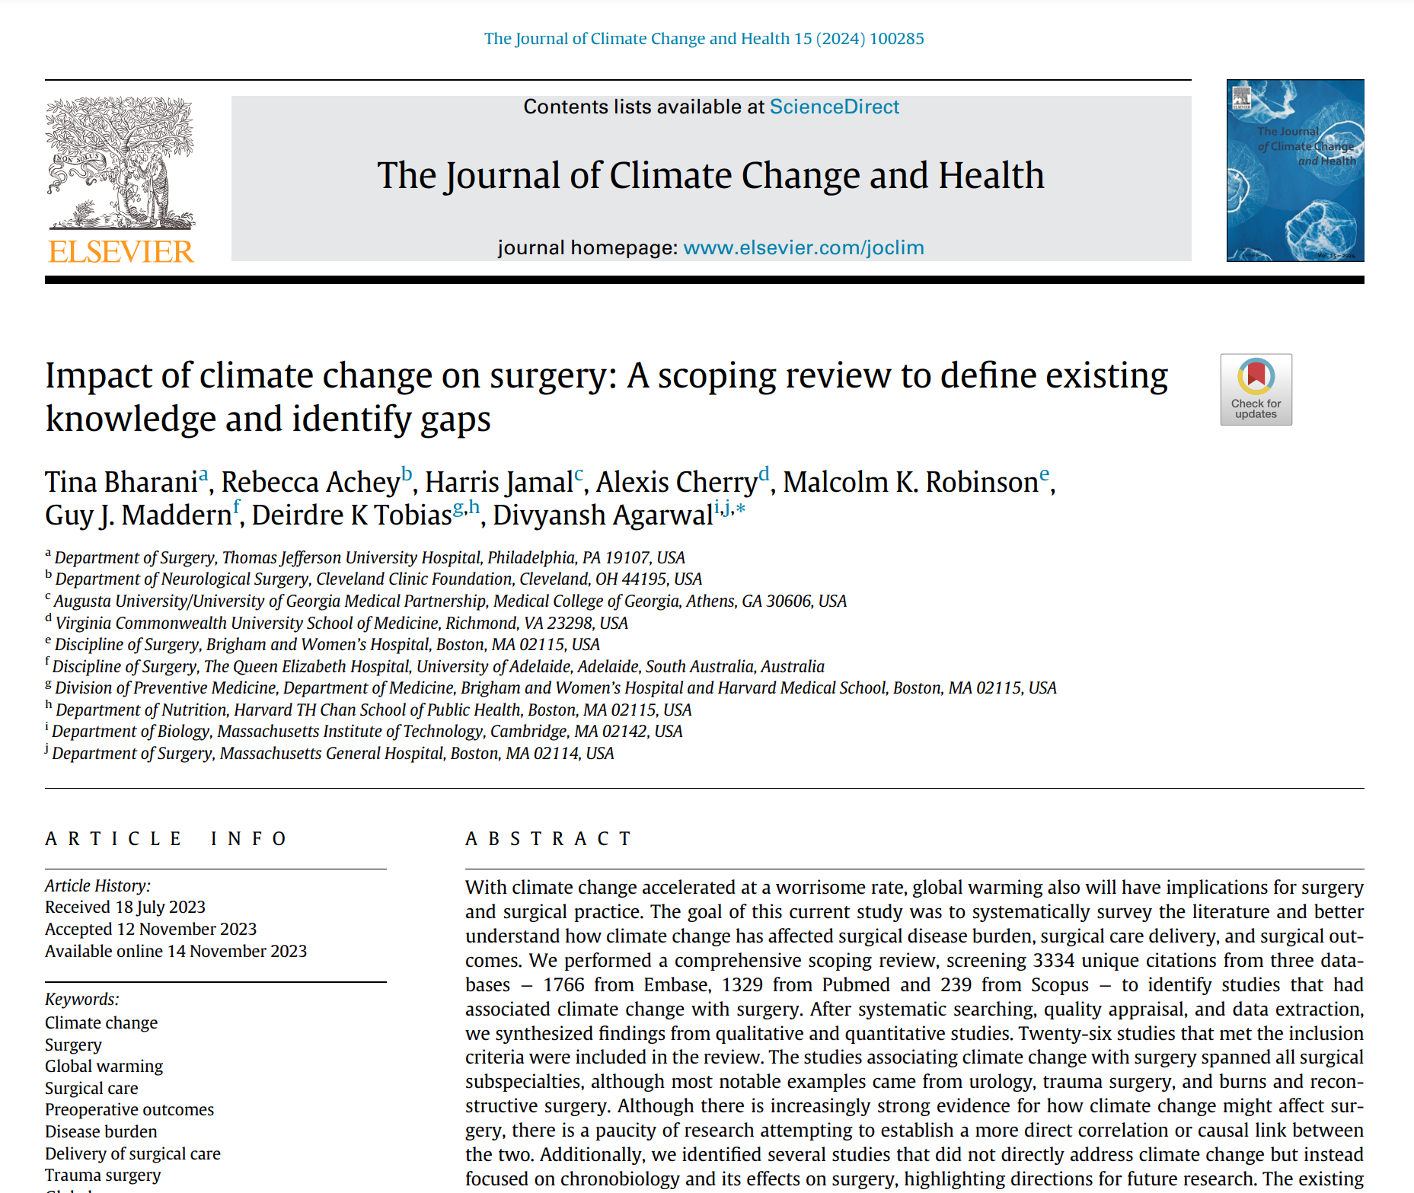
Increased temperatures
Urinary stone disease
Soft tissue infections
Injury risk
Wildfires, burns

Slide 26
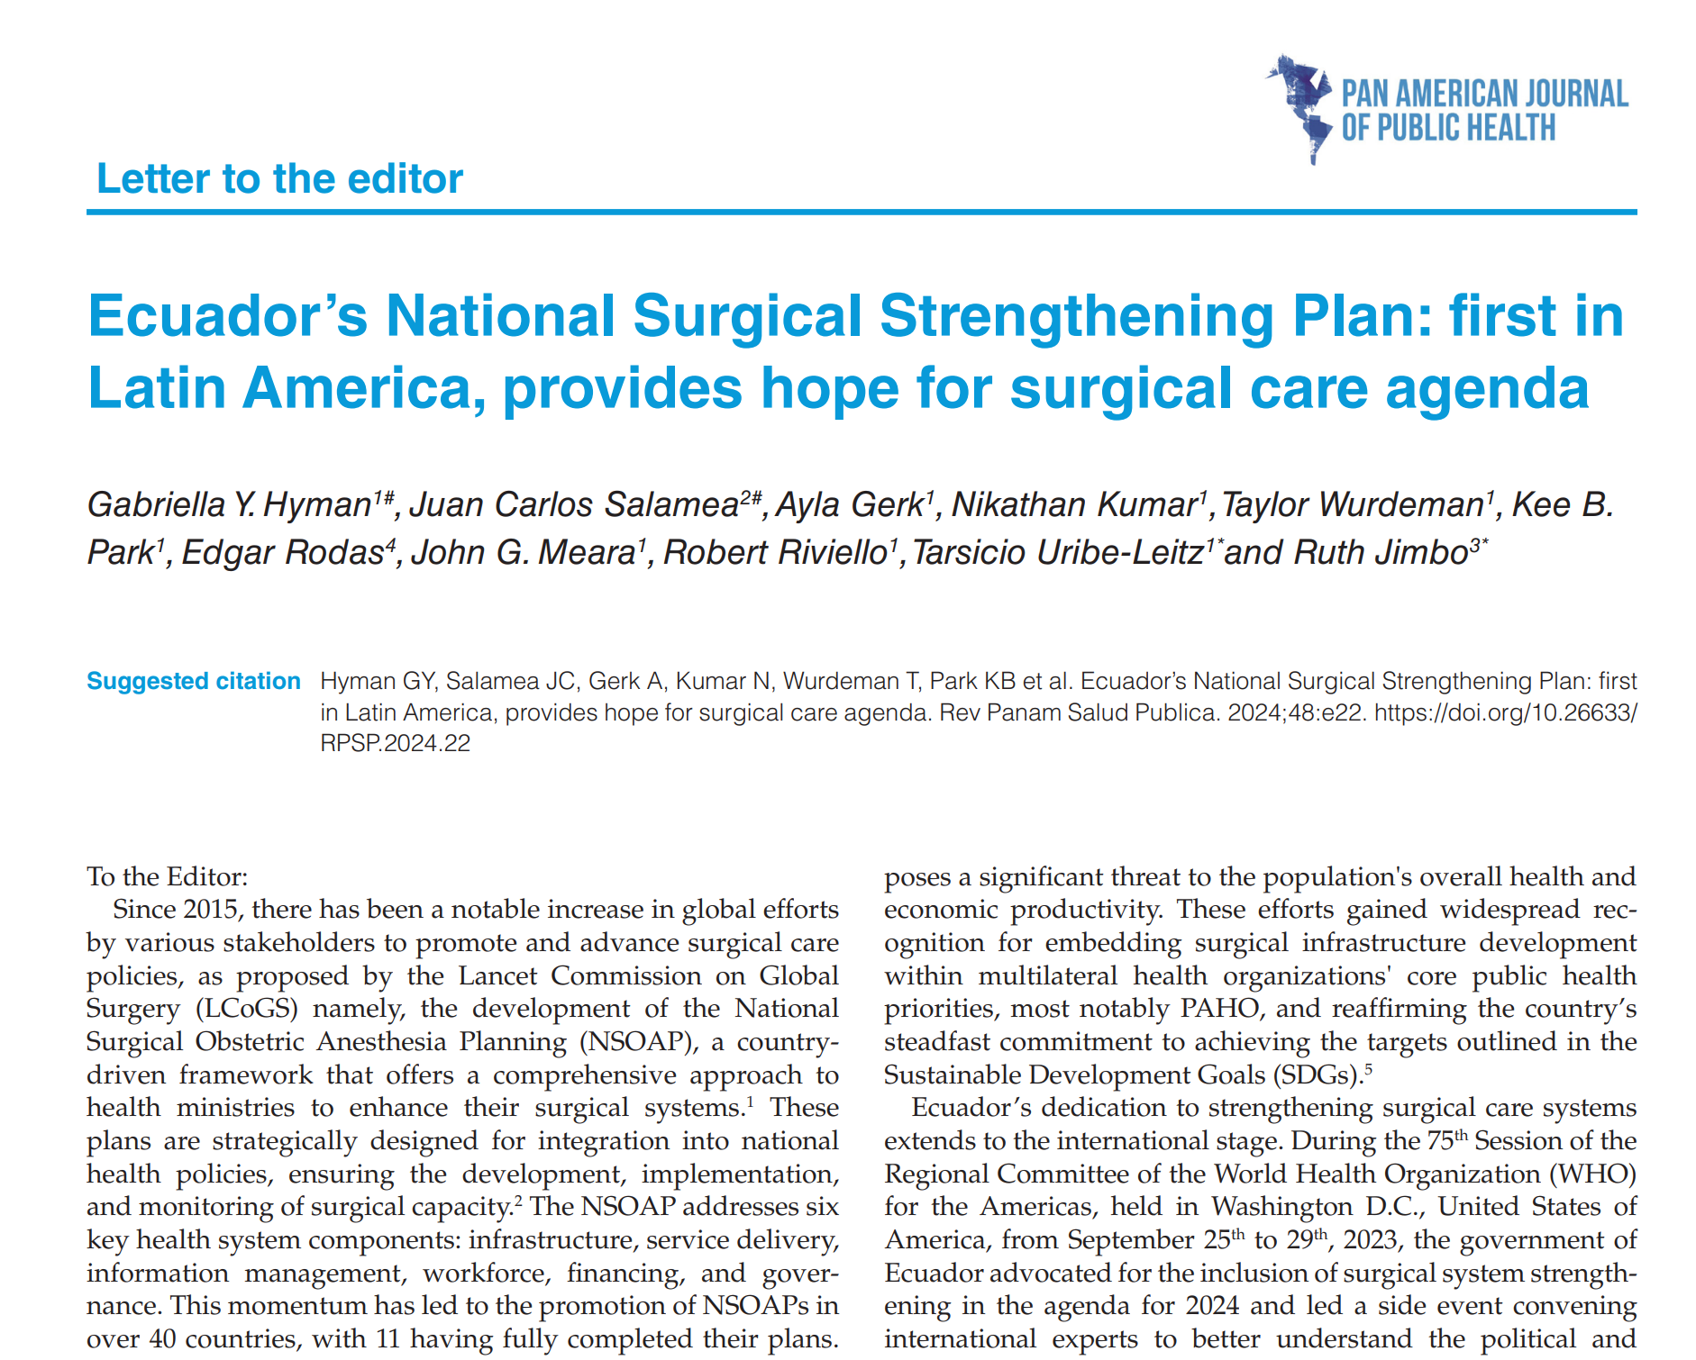
NSOAPs and Climate Change

Slide 27
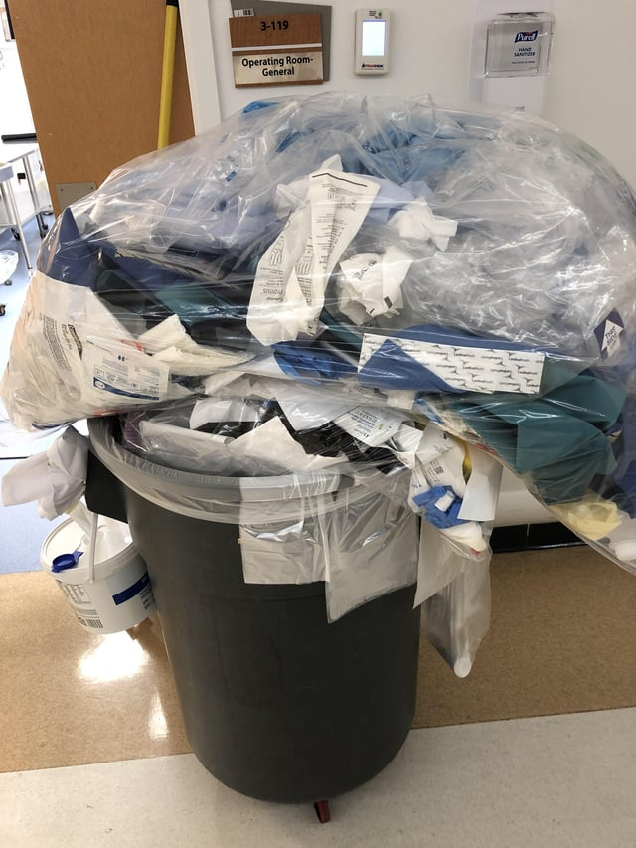
Local work

Slide 28

Implementation

